Slide 1
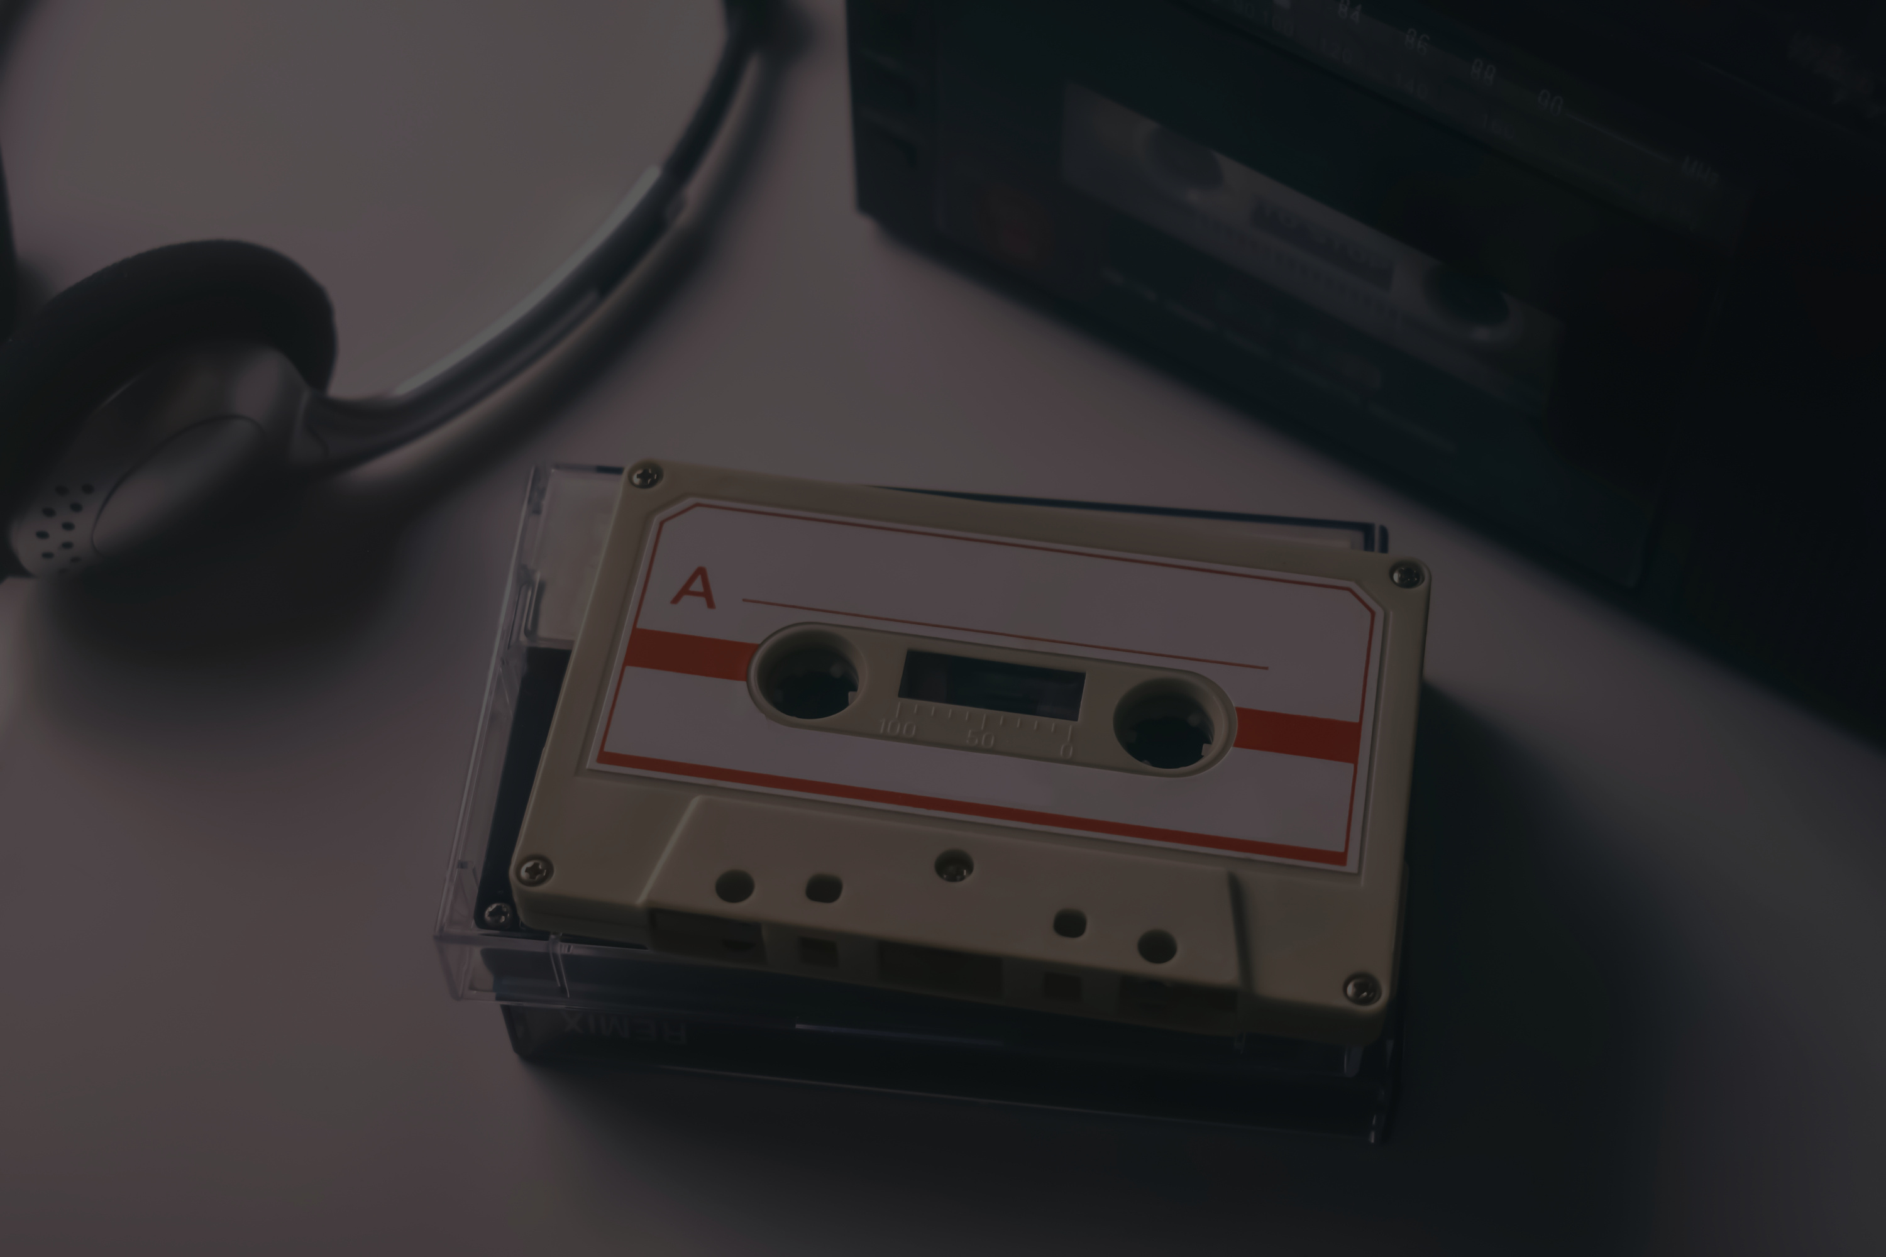



THE ART OF
MUSIC
Where Emotions Find Their Voice

Slide 2


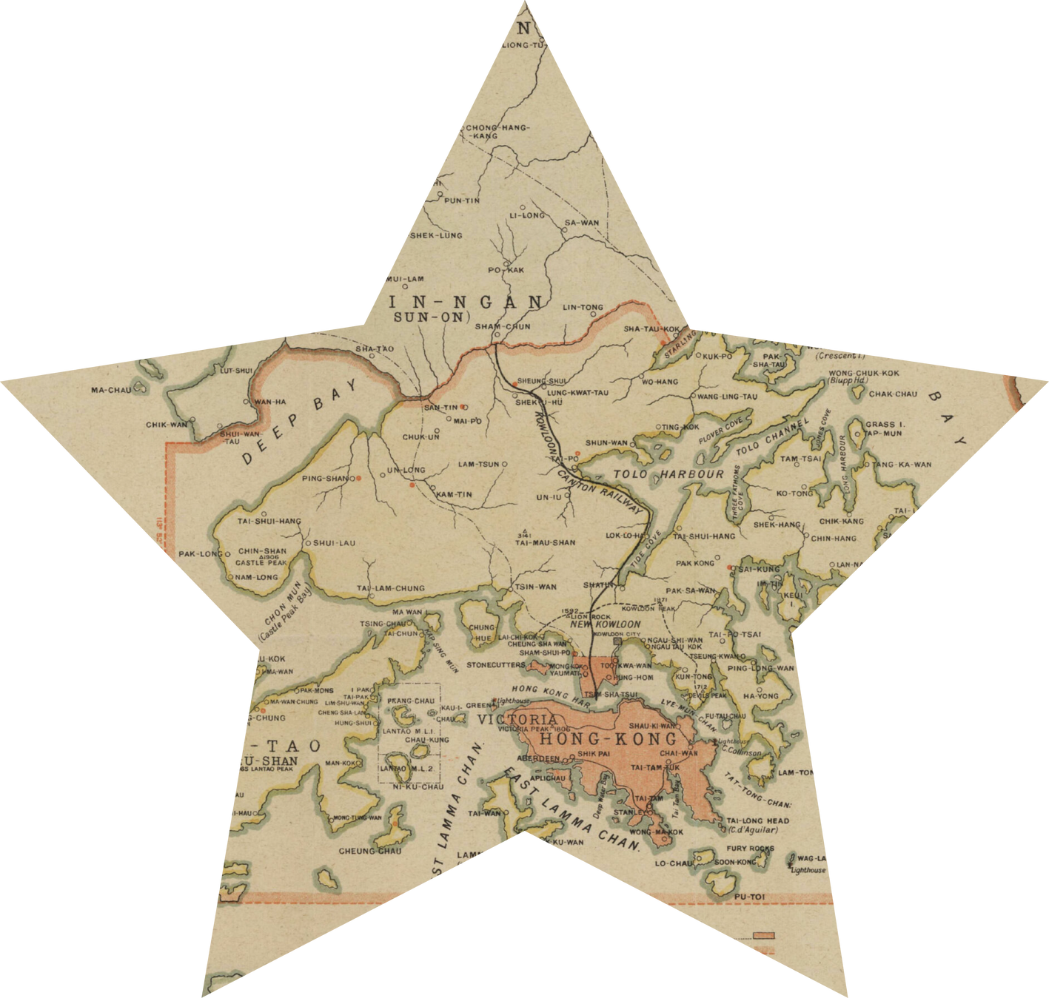
THE ESSENCE OF MUSIC
Chapter 1

Slide 3
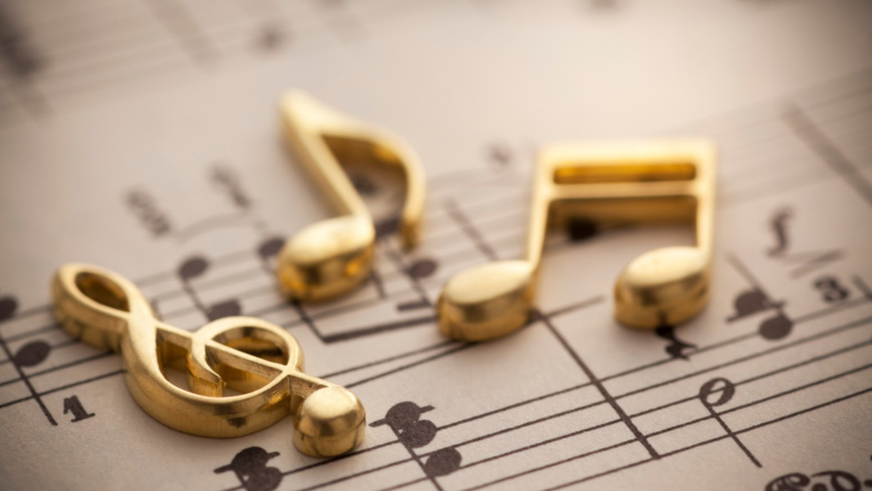
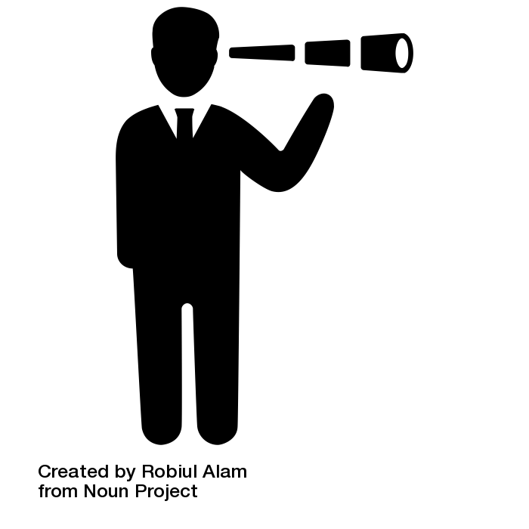

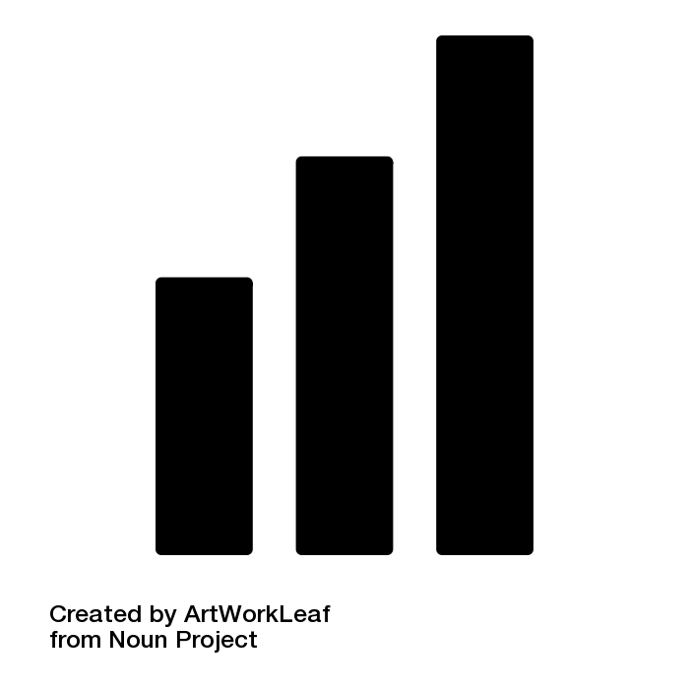

THE BRAIN LOVES MUSIC
WHAT IS MUSIC
Music isn't only fun—it's good for your brain!
It's an organized mixture of things such as melody and rhythm
MUSIC ACROSS CULTURES
THE BUILDING BLOCKS OF MUSIC
Music appears and sounds differently worldwide
Each song consists of fundamental elements: melody, harmony, rhythm
Div Vyas (D-125)

Slide 4
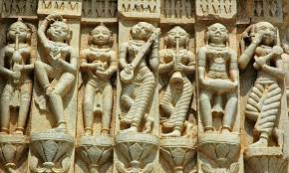
A JOURNEY THROUGH TIME AND HISTORY
Chapter 2

Slide 5
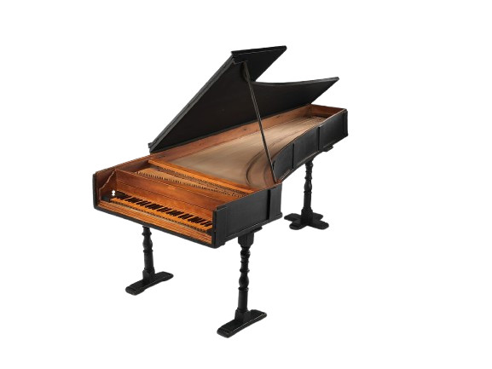
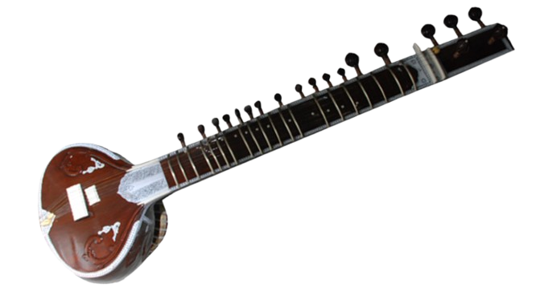





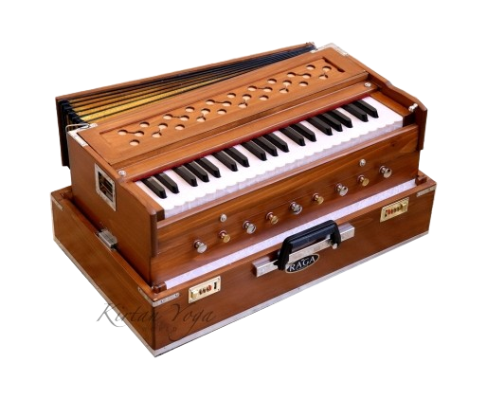
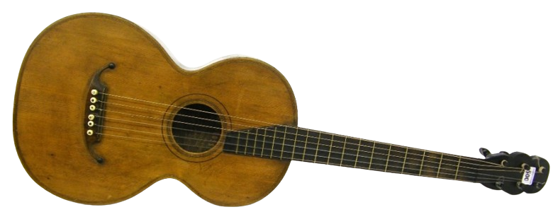
EVOLUTION OF MUSIC
ANCIENT ORIGINS
DIGITAL AGE
Primitive instruments like drums and flutes
CLASSICAL ERA
MODERN REVOLUTION
Streaming, AI-generated music
Birth of musical notation, Gregorian chants
Jazz, rock, pop, and electronic music emerged
Hetansh Waghela (D-126)

Slide 6
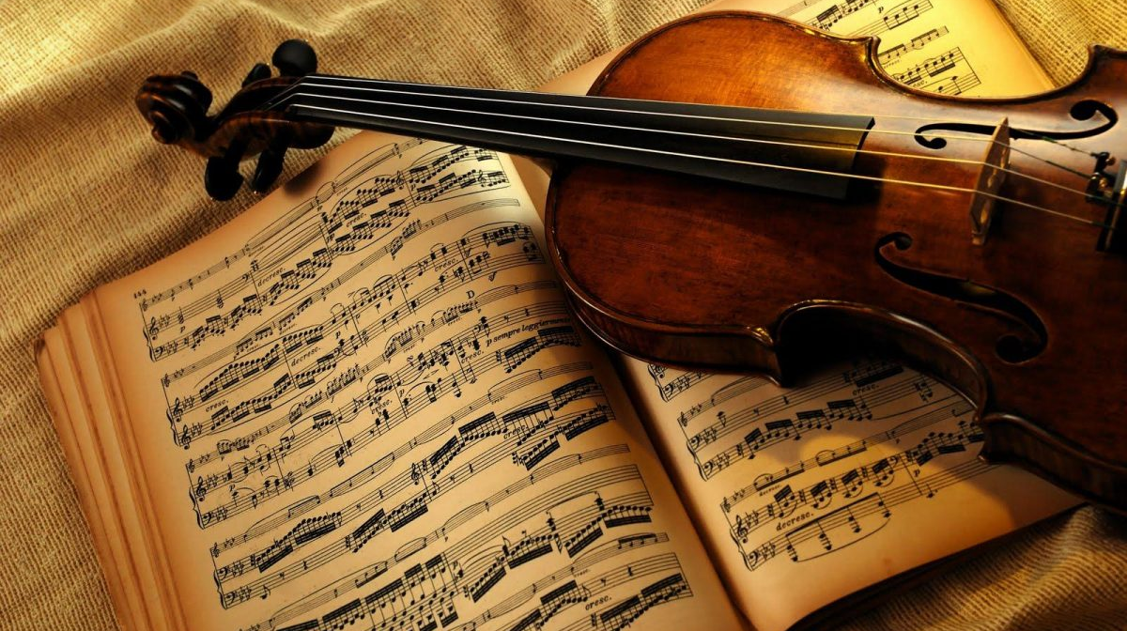
CLASSICAL MUSIC AND HEALTH
Chapter 3

Slide 7
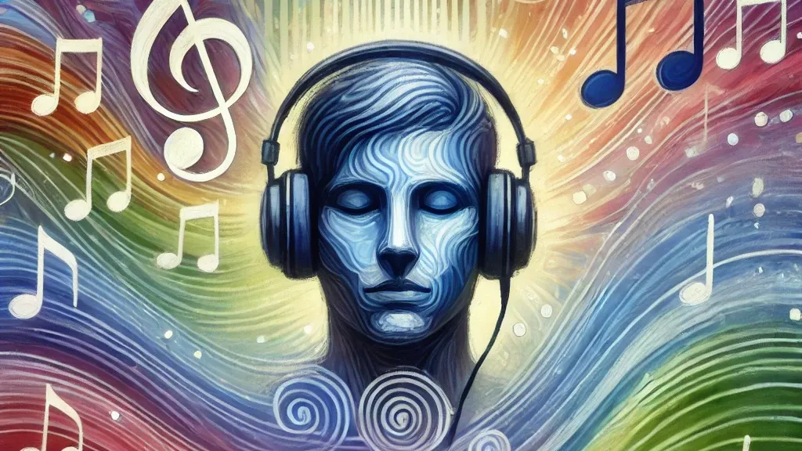
THE COGNITIVE POWER OF CLASSICAL MUSIC
02
04
01
STRESS REDUCTION
03
INFLUENCES WELL BEING
Lower heart rate, blood pressure, and cortisol levels
Engages the brain more richly than other genres
THE MOZART EFFECT
THERAPEUTIC USES
Boosts in spatial reasoning
Used in therapy for dementia, depression and anxiety
Vraj Ved (D-120)

Slide 8

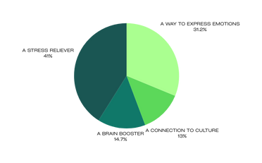
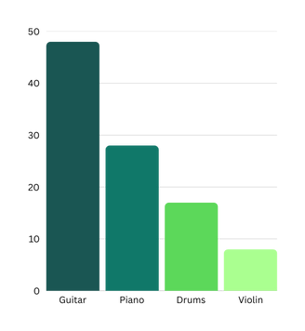
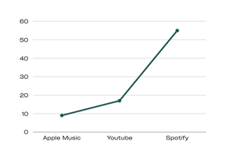
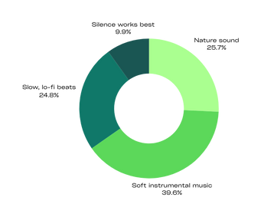
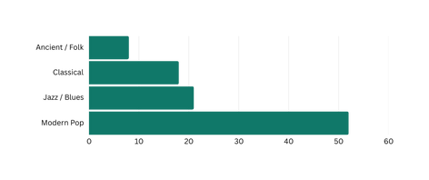
YOUR MUSIC, YOUR VOICE
SURVEY ANALYSIS
WHAT MUSIC MEANS TO US?
WHICH INSTRUMENT TO MASTER
MOST USED MUSIC PLATFORM
SPOTIFY ISN,T JUST WINNING, ITS CRUSHING THE MUSIC DISCOVERY GAME
SOUNDS THAT RELAXES THE MOST
MUSIC ERA MOST ENJOYED
MODERN POP DOMINATES MUSIC PREFERENCES, LEAVING OTHERS FAR BEHIND
Vraj Ved (D-120)

Slide 9

FOLK MUSIC: PRESERVING CULTURE
Chapter 4

Slide 10
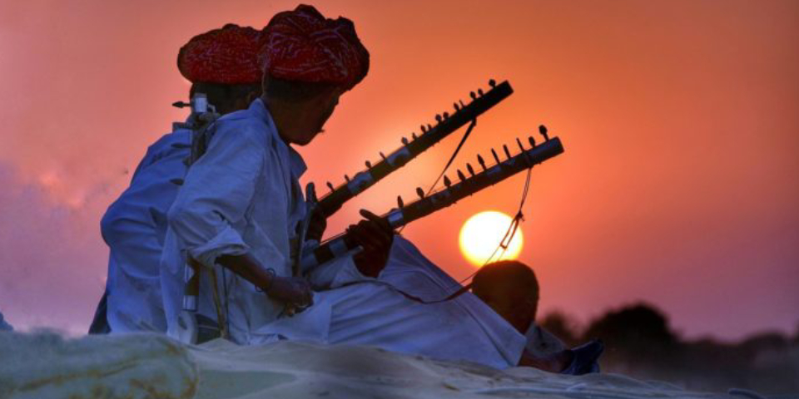





FOLK MUSIC: KEEPING TRADITIONS ALIVE
1
2
3
4
ON
ON
ON
ON
Harsh Singh (D-116)

Slide 11

FOLK MUSIC: KEEPING TRADITIONS ALIVE
1
2
3
4
ON
ON
ON
Music passed down through generations
Harsh Singh (D-116)

Slide 12
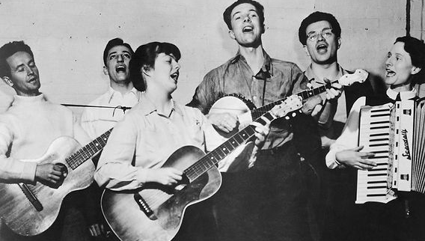

FOLK MUSIC: KEEPING TRADITIONS ALIVE
1
2
3
4
ON
ON
ON
Music passed down through generations
It was not written down
Harsh Singh (D-116)

Slide 13
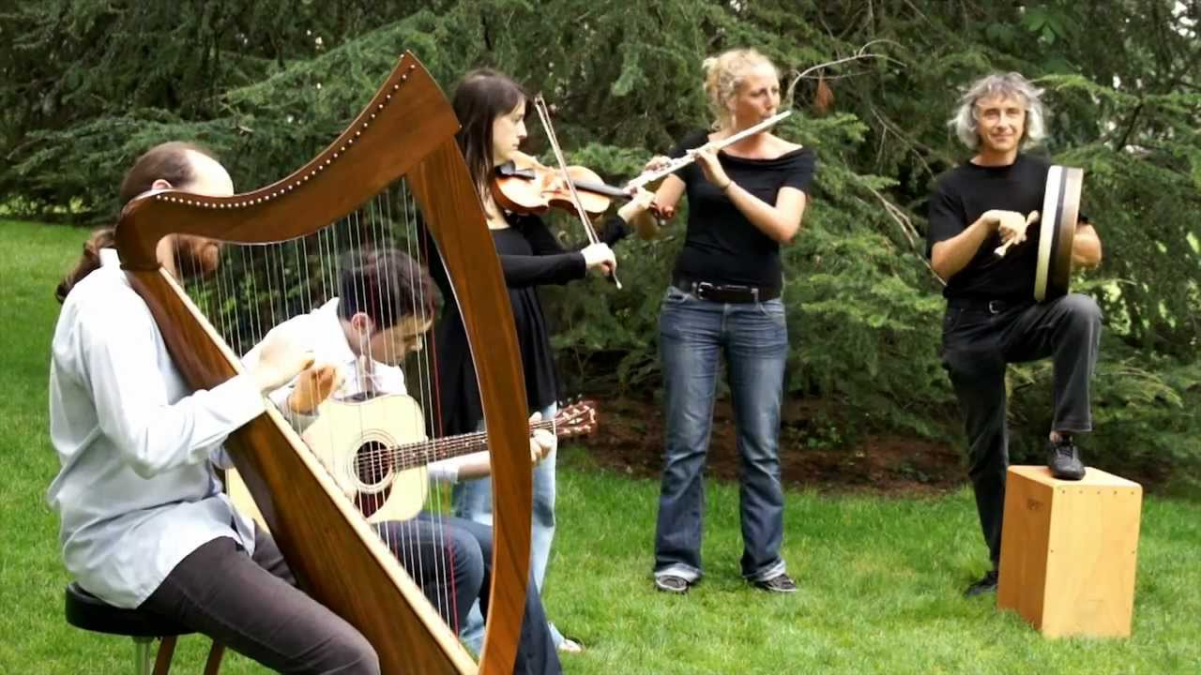

FOLK MUSIC: KEEPING TRADITIONS ALIVE
1
2
3
4
ON
ON
ON
Music passed down through generations
It was not written down
Unique to each region
Harsh Singh (D-116)

Slide 14


FOLK MUSIC: KEEPING TRADITIONS ALIVE
1
2
3
4
ON
ON
ON
Music passed down through generations
It was not written down
Unique to each region
Talks about love, work and nature
Harsh Singh (D-116)

Slide 15

MEDITATION MUSIC
Chapter 5

Slide 16
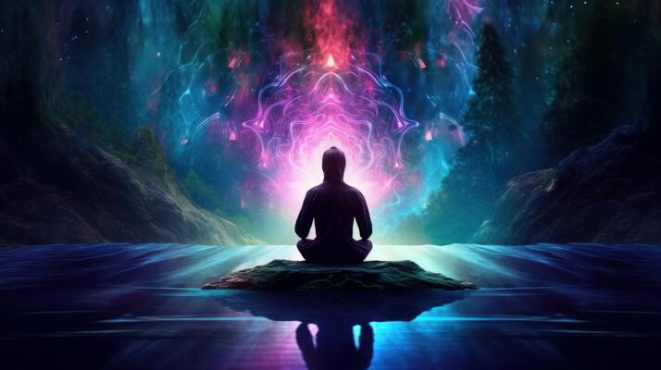



THE SCIENCE BEHIND SOUND
BRAINWAVE ENTRAINMENT
STRESS REDUCTION
Certain frequencies (e.g., alpha, theta waves) induce meditative states
Reduces heart rate, blood pressure, and stress hormone levels
02
04
01
03
NATURAL SOUND INTEGRATION
MENTAL CLARITY
Aids in anchoring attention and improving self-awareness.
Elements like water, birdsong, and wind promote tranquility and lower cortisol levels.
Maurya Trivedi (D-123)

Slide 17

ACOUSTICS: THE SCIENCE OF MUSIC
Chapter 6

Slide 18






THE PHYSICS OF SOUND
WHAT IS ACOUSTICS
B
Type of energy made by vibrations
Branch of physics concerned with the properties and behavior of sound
A
ACOUSTICS AND FUTURE OF MUSIC
ACOUSTIC PROPERTIES
ACCOUSTICS AND INNOVATION
String instruments produce sound through the vibrations of their strings
Knowledge of acoustics becomes even more valuable
C
E
ROOM ACOUSTICS AND SOUND PERCEPTION
D
The environment plays a significant role in how the sound is perceived
Aryan Tanna (D-118)

Slide 19
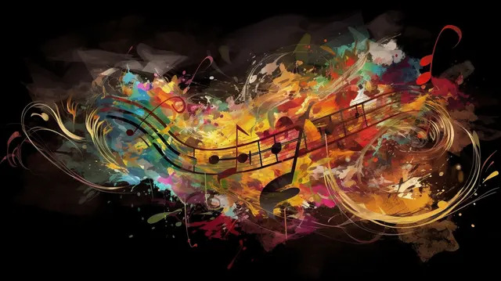
MODERN MUSIC AND HEALTH
Chapter 7

Slide 20






EXPLORING THE SOUNDS AND THEIR EFFECTS
01
02
03
04
05
POP MUSIC
ROCK MUSIC
ELECTRONIC MUSIC
HIP HOP
JAZZ MUSIC
Abhishek Upadhyay (D-119)

Slide 21
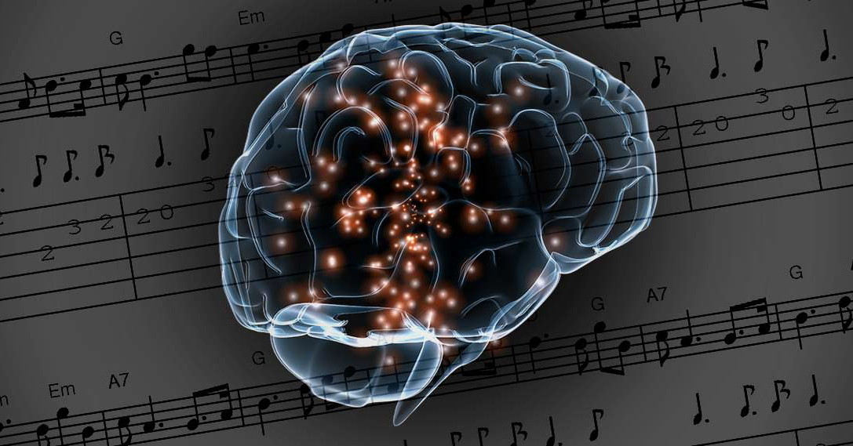
MUSIC THERAPY
Chapter 8

Slide 22
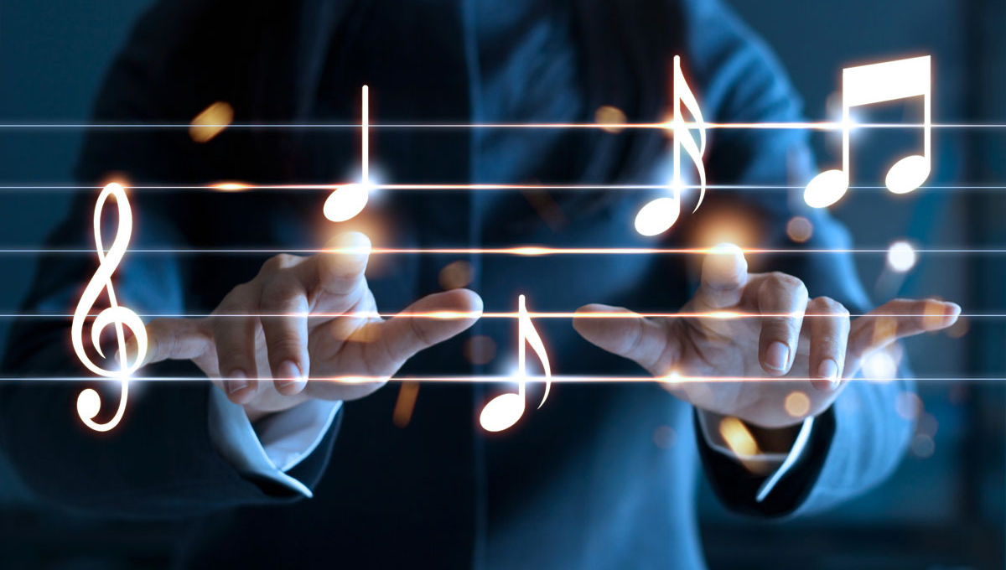



HEALING THROUGH HARMONIES
02
TYPES OF MUSIC THERAPY
03
WHAT DO WE EXPECT AFTER MUSIC THERAPY SESSION
01
WHAT IS MUSIC THERAPY
Ishaan Vorani (D-124)

Slide 23
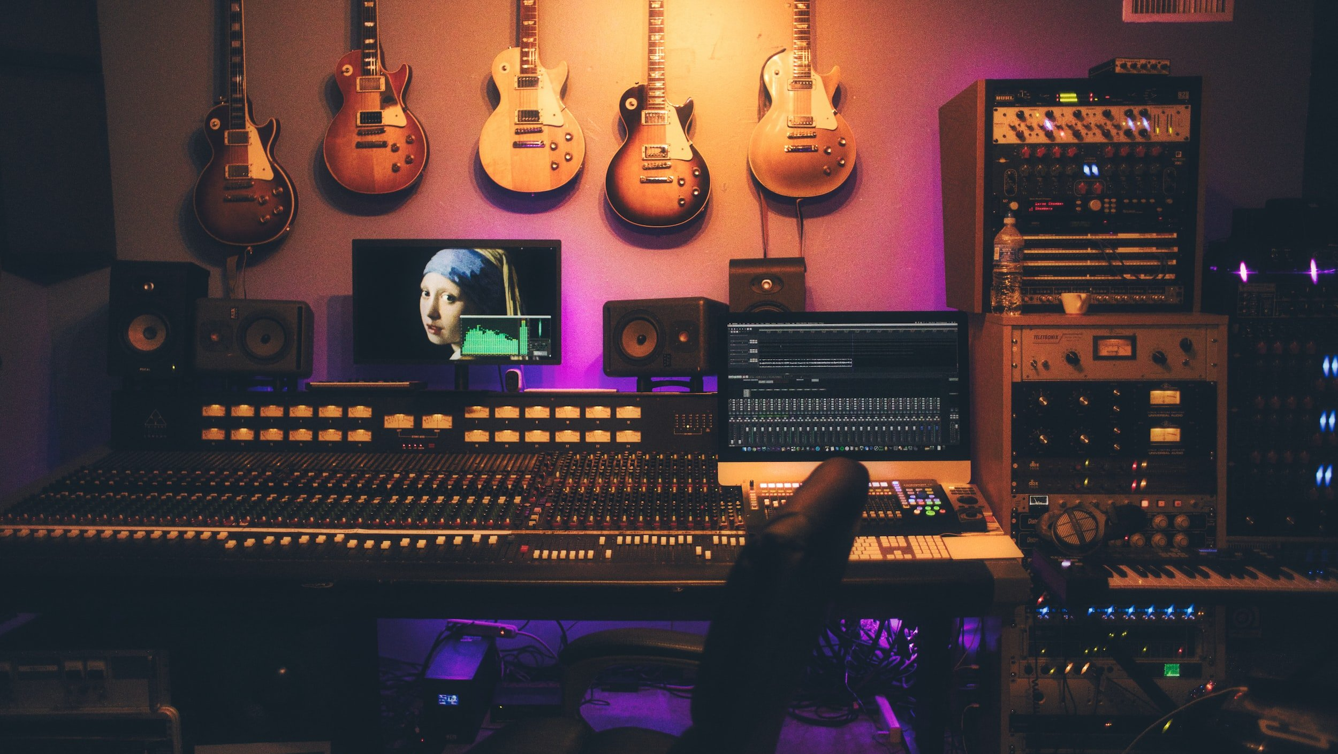
MUSIC AND TECHNOLOGY
Chapter 9

Slide 24





Digital Instruments & Creative Tools
02
04
Streaming Platforms & Music Consumption
01
05
03
Broader Effects: Culture, Environment & History
Technology’s Role in Music Production
Impact on Artists & the Industry
Vrushti Vora (D-122)

Slide 25
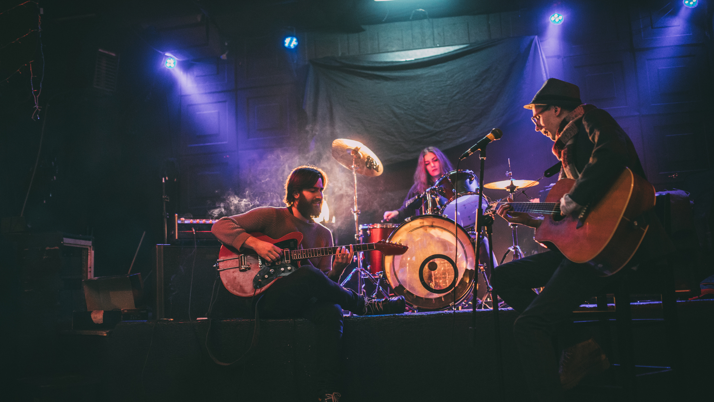
MUSIC AND SOCIAL MOVEMENTS
Chapter 10

Slide 26
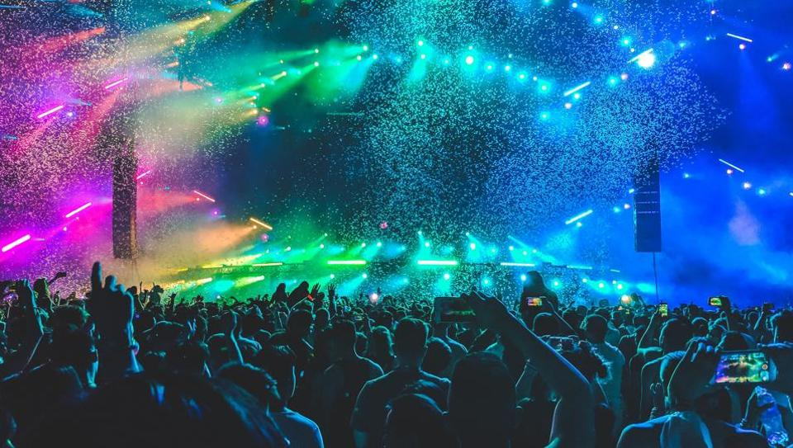


Bringing people together
Spreading messages
Keeping history alive
Raising awareness
Meet Tank (D-117)

Slide 27
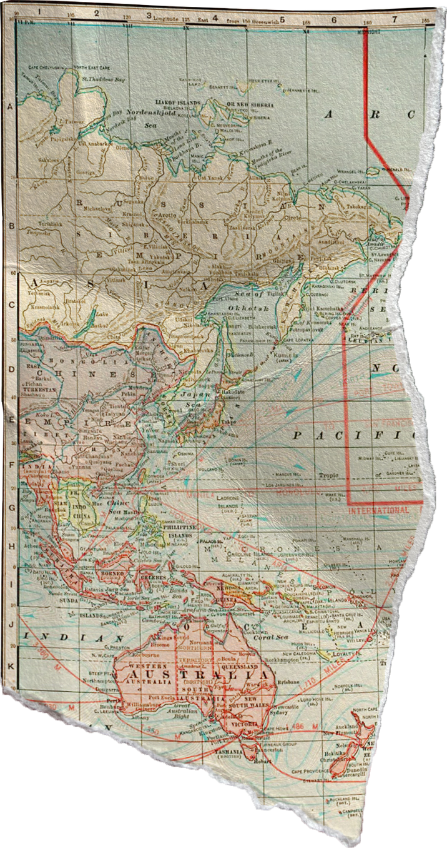


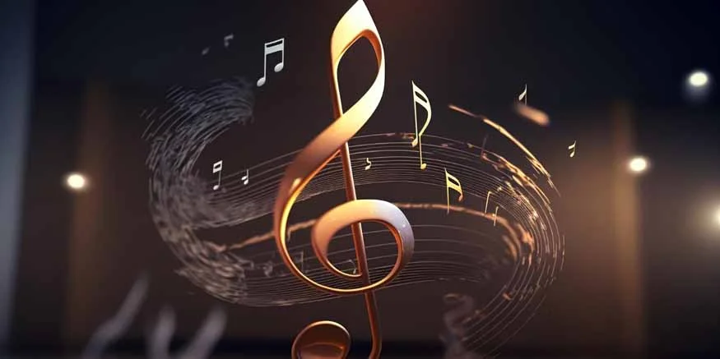
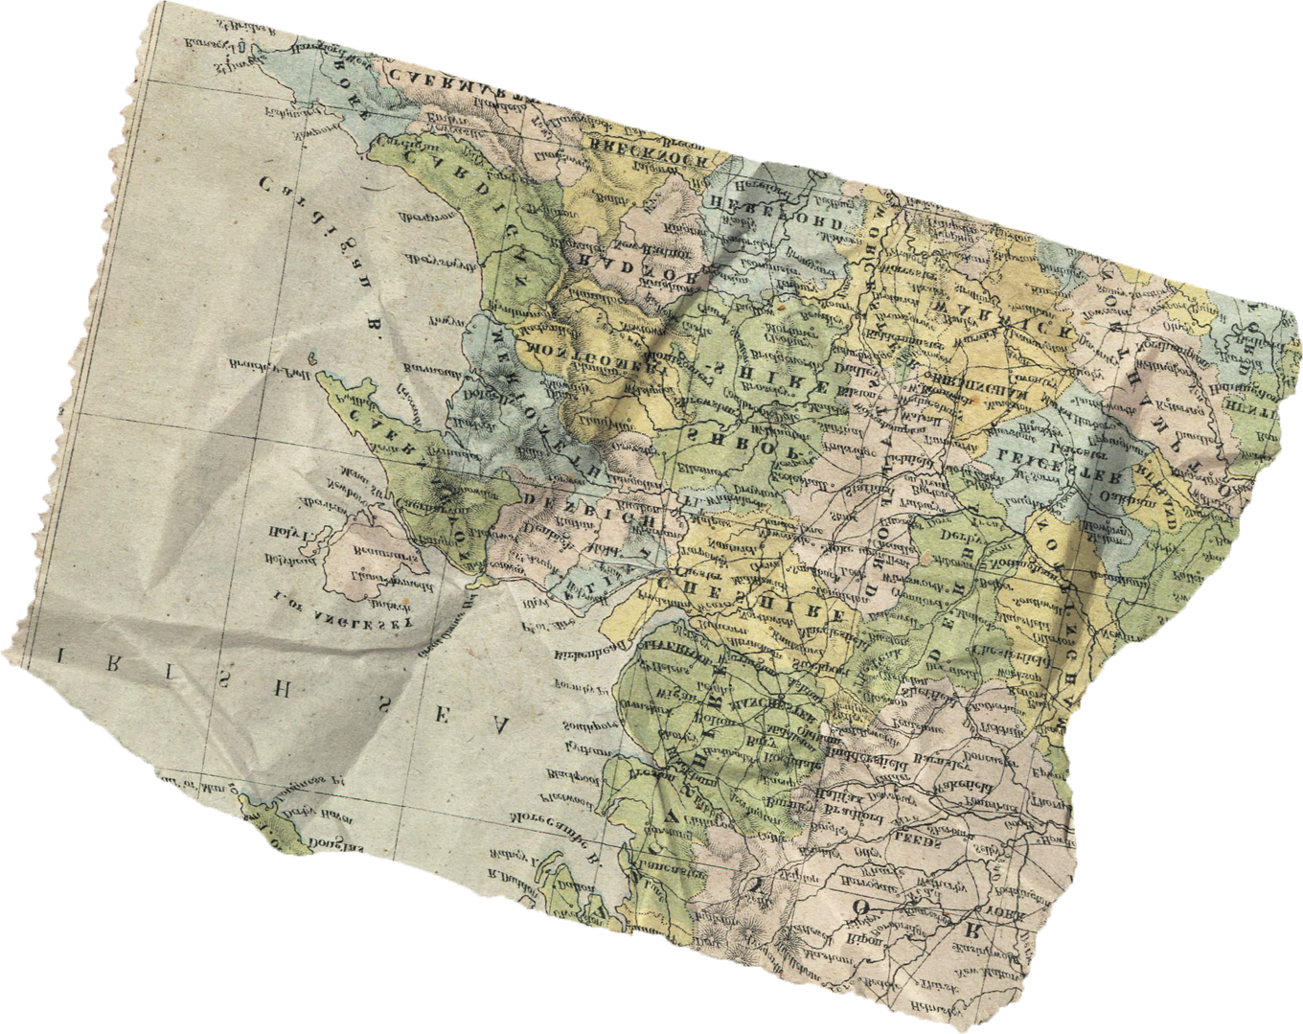
CONCLUSION
Darshan Ved (D-121)

Slide 28
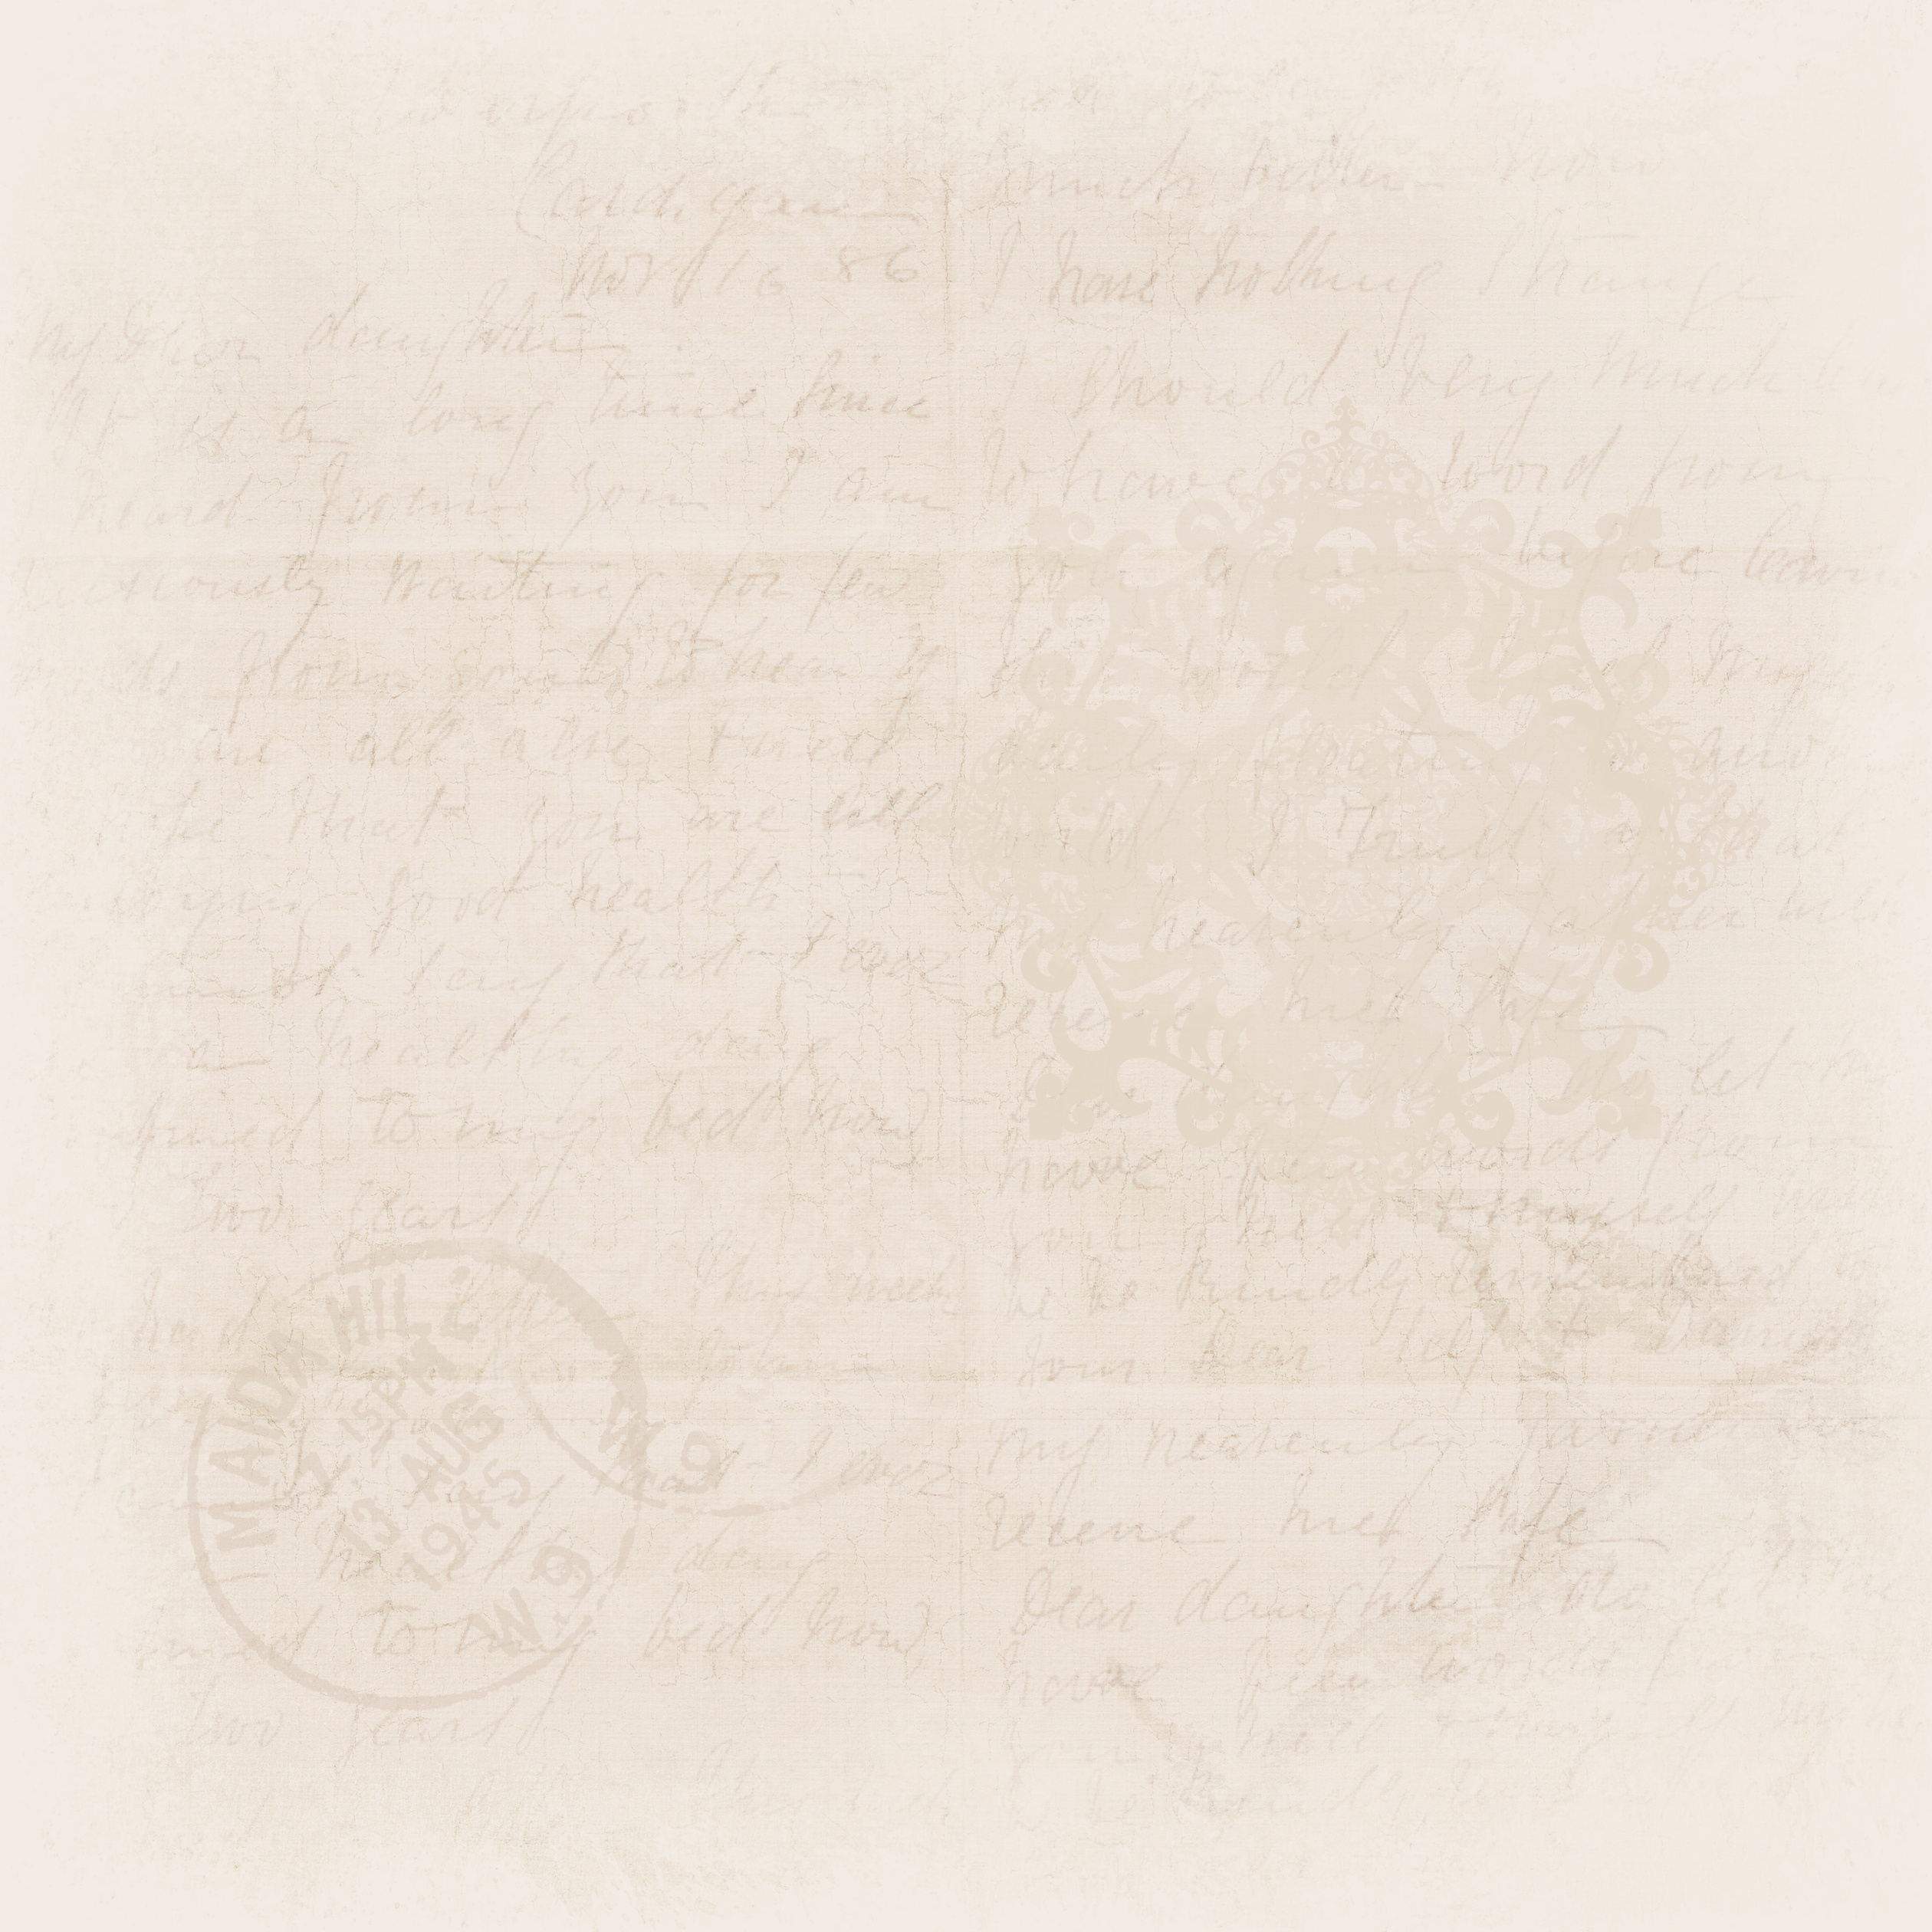

THANK YOU
Presented by: Harsh Singh (D-116)
Meet Tank (D-117)
Aryan Tanna (D-118)
Abhishek Upadhyay (D-119)
Vraj Ved (D-120)
Darshan Ved (D-121)
Vrushti Vora (D-122)
Maurya Trivedi (D-123)
Ishaan Vorani (D-124)
Div Vyas (D-125)
Hetansh Waghela (D-126)
Thank You audience for listening to us
Thanks to all group members who gave their best in the making of this project

